Slide 1


Slide 2
Introduction To Assembly
Little Man Computer

Slide 3
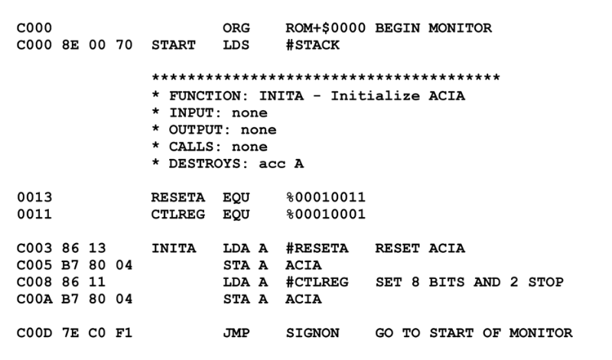
Assembly Language
What is assembly?
Assembly language is a low level programming language
Typically just above binary instructions
There is usually a 1 to 1 correspondence between assembly instructions and machine instructions
Notes:
Can be found online… but I can’t link to it

Slide 4
Assembly Language
Machine instructions == machine dependent
Assembly language is specific to a particular architecture
Recall the saying “C is portable assembly”
This is because the C compiler can target different architectures
Notes:
Can be found online… but I can’t link to it

Slide 5
Assembly Language
Is C really portable assembly?
Assembly typically does not have:
Function calls
Structs
Arrays
Loop constructs
Notes:
Can be found online… but I can’t link to it

Slide 6
Assembly Language
Is C really portable assembly?
Assembly typically does have:
Jumps
Raw access to registers
It’s a ton of work to get anything done
Notes:
Can be found online… but I can’t link to it

Slide 7
Assembly Language
Is C really portable assembly?
I would say that’s a good joke, but no, as low level as C is, it is much more than portable assembly
Notes:
Can be found online… but I can’t link to it

Slide 8
Assembly Language
The assembler
Takes assembly code and converts it into binary instructions
Part of the gcc tool chain: C → assembly → object file → executable file
Notes:
Can be found online… but I can’t link to it

Slide 9
Assembly Syntax
Assembly code is typically a linear set of instructions, labels and directives
Assembly instructions correspond to single instructions on the CPU
Labels are used to refer to things by address
Directives can be comments, hints to the assembler, etc.
Notes:
Can be found online… but I can’t link to it

Slide 10
Understanding Assembly
To understand assembly, you have to understand the underlying hardware
One of the difficult things about x86 is that the hardware is a little insane
We are going to start with very simple hardware instead
Notes:
Can be found online… but I can’t link to it

Slide 11
MC6800 Assembly
The code at right is some assembly taken from the MC6802 processor
1Mhz
64 Kbyte memory address capacity
16-bit
2 accumulator registers, A&B
Stack pointer (we will discuss more on stack pointers later)
Index Register
Condition Code Register (AKA a flags register)
Notes:
Can be found online… but I can’t link to it

Slide 12
MC6800 Assembly
Note the explicit addresses and machine code (in hex form) in the program
This is how people used to deal with computers!
And some still do, in embedded programming
Notes:
Can be found online… but I can’t link to it

Slide 13
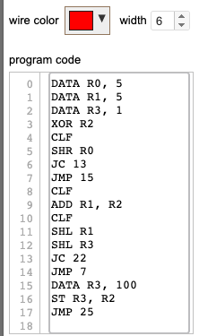
Scott CPU Assembly
We have already seen some assembly for the Scott CPU
Much less “fiddly” than the motorola assembly at right
Closer, in some ways, to modern assembly
Notes:
Can be found online… but I can’t link to it

Slide 14
Scott CPU Assembly
Still annoying in some ways
No labels, for example
Due to 8 bit architecture, some assembly instructions map to two bytes, which makes things more complex
Notes:
Can be found online… but I can’t link to it

Slide 15
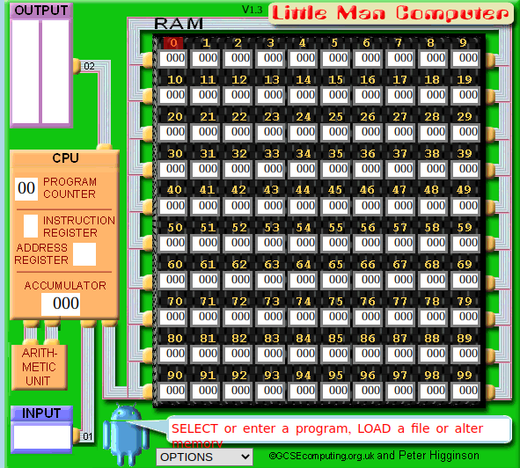
Little Man Computer
The Little Man Computer (LMC)
An extremely simple model of a computer
Proposed by Dr. Stuart Madnick in 1965
Models a simple von Neumann architecture machine
Has the basic operations of a modern computer, but much easier to understand
Notes:
Can be found online… but I can’t link to it

Slide 16
Little Man Computer
LMC simplifications
100 memory slots
Addresses are in decimal
No binary or hex to confuse us
There is only one general purpose register, called the accumulator
Values between -999 and 999 are supported
Notes:
Can be found online… but I can’t link to it

Slide 17
Little Man Computer
LMC Architecture
Program Counter - points to the current instruction (starts at 0)
Instruction Register - the current instruction being executed
Address Register - an address associated with the current instruction (if any)
Input/Output - Rudimentary I/O devices to read and print numbers
Notes:
Can be found online… but I can’t link to it

Slide 18
Little Man Computer
LMC Architecture
RAM - a continuous array of decimal values from position 0 to 100
Note that there is no distinction between instructions and data in memory
Notes:
Can be found online… but I can’t link to it

Slide 19
Little Man Computer
LMC Execution Cycle
Check the Program Counter
Fetch the instruction from that address
Increment the Program Counter
Decode the fetched instruction into the Instruction and Address registers
Fetch any data needed
Execute the instruction
Branch or store the result
Repeat!
Notes:
Can be found online… but I can’t link to it

Slide 20
Little Man Computer
LMC Instruction Set
LMC Instructions are 3 decimals
First decimal indicates the instruction type
Next two decimals are optional arguments for that instruction
Notes:
Can be found online… but I can’t link to it

Slide 21
LMC - Math
ADD
1XX - adds the value stored in location XX to whatever value is currently in the Accumulator
SUB
2XX - subtracts the value stored in location XX from whatever value is in the Accumulator
Notes:
Can be found online… but I can’t link to it

Slide 22
LMC - Memory
STA
3XX - stores the value in the Accumulator into the memory location XX
LDA
5XX - loads the value in the memory location XX into the Accumulator
Notes:
Can be found online… but I can’t link to it

Slide 23
LMC - Control Flow
BRA
6XX - unconditionally sets the Program Counter to the memory location XX
BRZ
7XX - branches to the location XX if the accumulator is zero
BRP
8xx - branches to the location XX if the accumulator is 0 or positive
Notes:
Can be found online… but I can’t link to it

Slide 24
LMC - Input/Output
INP
901 - Ask the user for numeric input, to be stored in the Accumulator
OUT
902 - Write the current accumulator value to the output area
HLT/COB
000 - end the program, halt, take a coffee break
Notes:
Can be found online… but I can’t link to it

Slide 25
LMC - Input/Output
DAT <value>
Used to indicate that the value should be stored at the memory location corresponding to this instruction
Notes:
Can be found online… but I can’t link to it

Slide 26
LMC
That’s it!
A total of 10 instructions
But we can still do some interesting things with them
More complex architectures add more instructions and infrastructure (registers, etc.)
But the fundamentals are the same
Notes:
Can be found online… but I can’t link to it

Slide 27
LMC
We will be using the excellent LMC simulator at https://peterhigginson.co.uk/LMC/
DEMO TIME!
Notes:
Can be found online… but I can’t link to it

Slide 28
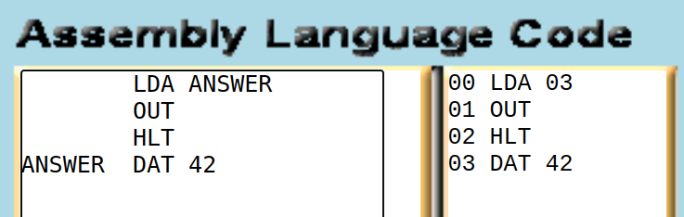
LMC - Labels
A nice way to avoid having to hard code addresses into your assembly program
Provide a symbolic way to refer to jump targets or data loads
Here we are storing 42 at the 4th position and loading it via a label
Notes:
Can be found online… but I can’t link to it

Slide 29
LMC - Labels
Labels also become important as we implement things like loops or conditional branches in our assembly program
Notes:
Can be found online… but I can’t link to it

Slide 30
Assembly Review
Assembly is very low level programming, typically just above machine code
Assembly programs consist mainly of a linear sets of instructions, as well as data, assembly directives, etc.
We are going to begin working with assembly using the LMC architecture
Simple and Fun!
Despite the simplicity, it shows us the core operations in any assembly language
Next: implementing some stuff in LMC!

